Slide 1
Clinical metagenomics
Nick Loman

Slide 2
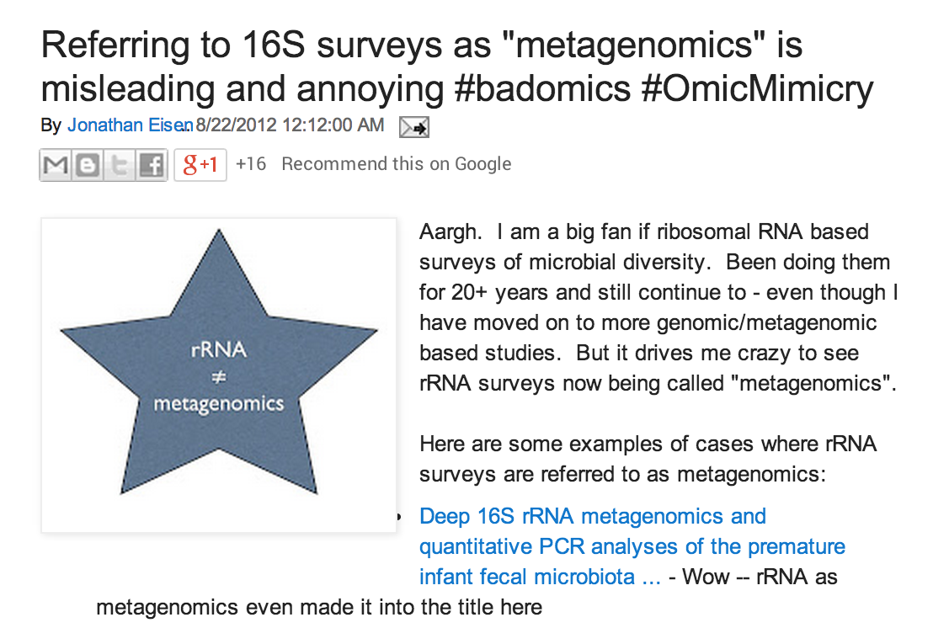
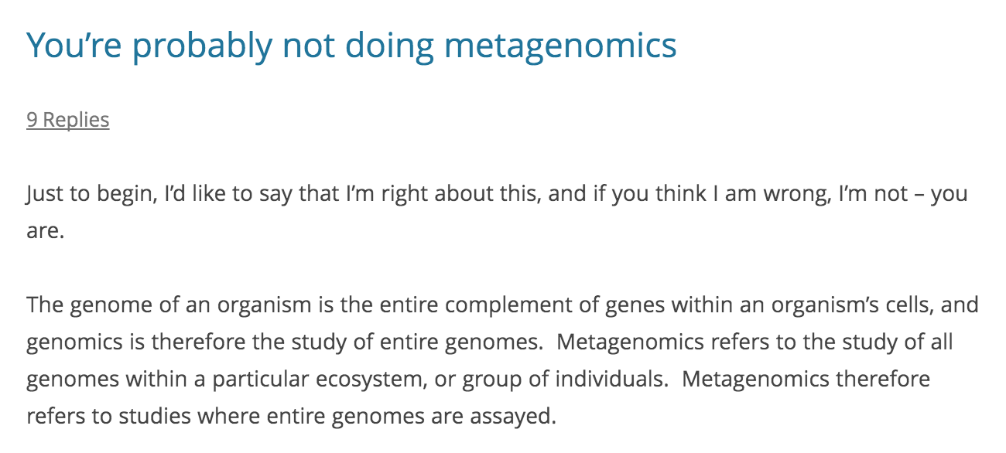
Jonathan Eisen
Mick Watson

Slide 3
16S vs metagenomics
Cheap
Targets single marker gene
Limited to bacteria
Relatively easy to analyse
Lots of known biases
Taxonomic assignment at species level problematic
Function can only be inferred, not detected
Goes deeper
Expensive
In theory can detect anything
Harder to analyse
Fewer biases (?)
Function information directly accessible
Strain-level information
Shallower

Slide 4
Definition of a metagenome
The collection of genomes and genes from the members of a microbiota
Microbiota: The assemblage of microorganisms present in a defined environment.
Microbiome: This term refers to the entire habitat, including the microorganisms, their genomes (i.e., genes) and the surrounding environmental conditions.
http://www.allthingsgenomics.com/blog/2013/1/11/the-vocabulary-used-to-describe-microbial-communities-microbiome-metagenome-microbiota

Slide 5
Metagenomics – Your questions

Slide 6
What’s the big idea?
Who is there? (Taxonomic assignments)
What are they doing? (Functional analysis)
What are they capable of doing? (DNA)
Who is doing what? (Genome reconstruction)

Slide 7
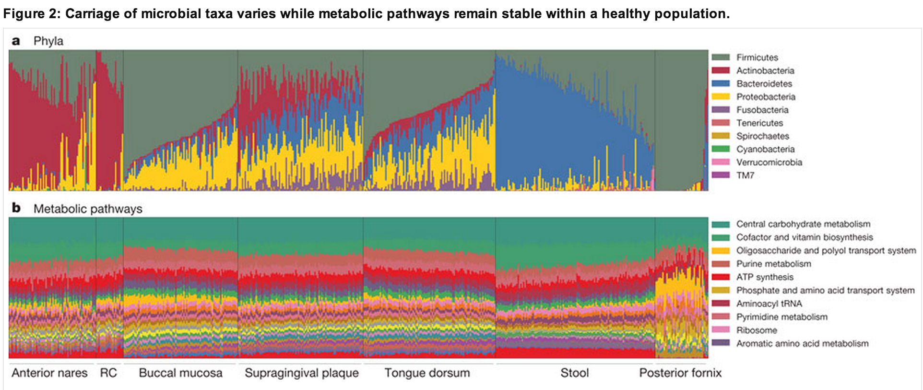
Functional signatures are not the same as taxonomic signatures
The Human Microbiome Project Consortium, doi:10.1038/nature11234

Slide 8
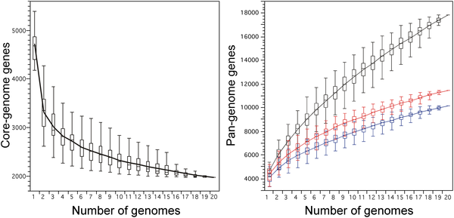
E. coli: more genes than humans?
Touchon et al. doi:10.1371/journal.pgen.1000344
Notes:
Number of genes in common (left) and total number of non-orthologous genes (right) for a given number of genomes analysed for the different strains of E. coli. The upper and lower edges of the boxes indicate the first quartile (25th percentile of the data) and third quartile (75th percentile), respectively, of 1000 random different input orders of the genomes. The central horizontal line indicates the sample median (50th percentile). The central vertical lines extend from each box as far as the data extend, to a distance of at most 1.5 interquartile ranges (i.e., the distance between the first and third quartile values). At 20 sequenced genomes, the core-genome had 1976 genes (11% of the pan-genome), whereas the pan-genome had (i) 17 838 total genes (black), (ii) 11 432 genes (red) with no strong relation of homology (<80% similarity in sequence), and (iii) 10 131 genes (blue) after removing insertion sequence-like elements (3834, 21% of all genes) and prophage-like elements (3873, 22% of all genes).

Slide 9
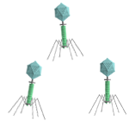
Genetics of virulence
Many virulence genes acquired via horizontal gene transfer
On plasmids or chromosome via conjugation
As naked DNA via transformation
On bacteriophage via transduction

Slide 10
Digital microbiology: Is high-throughput sequencing a match for Koch and Pasteur?

Slide 11
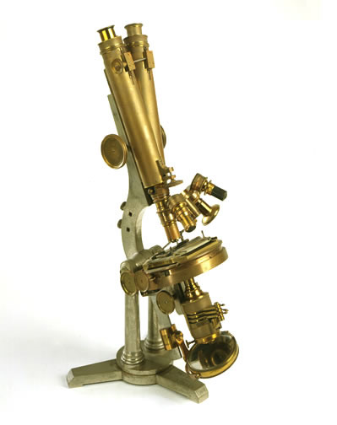
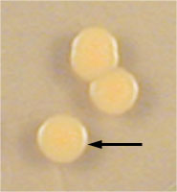
Diagnostic microbiology 21st Century problem, but 19th Century techniques!
Current Approaches
Future Vision
Microscopy and culture techniques that date from the time of Koch and Pasteur
Digital microbiology
High-throughput sequencing becomes method of choice in diagnostic microbiology

Slide 12
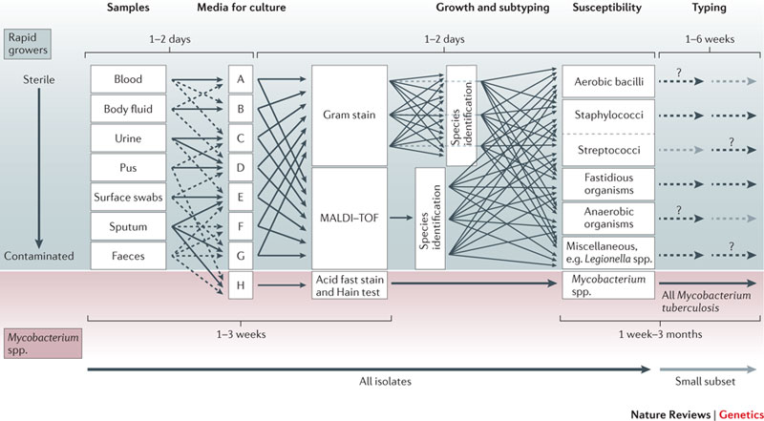
Clinical microbiology workflow
Didelot, Crook et al. PMID 22868263
Notes:
complex
Samples that are likely to be normally sterile are often cultured on a rich medium that will support the growth of any culturable organism. Samples that are contaminated with colonizing flora present a challenge for growing the infecting pathogen. Many types of culture media (referred to as selective media) are used to favour the growth of the suspected pathogen; this approach is particularly important for culturing pathogens from faeces. Boxes A to H arbitrarily represent the many different media for culture. The medium H represents a medium designed for growing mycobacteria that have specific growth requirements. When an organism is growing, the morphological appearance and density of growth are properties that need specialist knowledge for deciding whether it is likely to be pathogenic. The likely pathogens are then processed through a complex pathway that has many contingencies to determine species and antimicrobial susceptibility. Broadly, there are two approaches. One approach uses matrix-assisted laser desorption/ionization–time of flight (MALDI–TOF) mass spectrometry for species identification before setting up susceptibility testing. The other uses Gram staining followed by biochemical testing to determine species; susceptibility testing is often set up simultaneously with doing biochemical tests. Categorization of pathogens into groups of species is needed to choose the appropriate susceptibility-testing panel. Finally, depending on the species and perceived likelihood of an outbreak, a small subset of isolates may be chosen for further investigation using a wide range of typing tests that are often only provided by reference laboratories. The dashed lines and question marks are positioned arbitrarily to indicate that the further investigation is varied and happens in only a small number of cases.

Slide 13
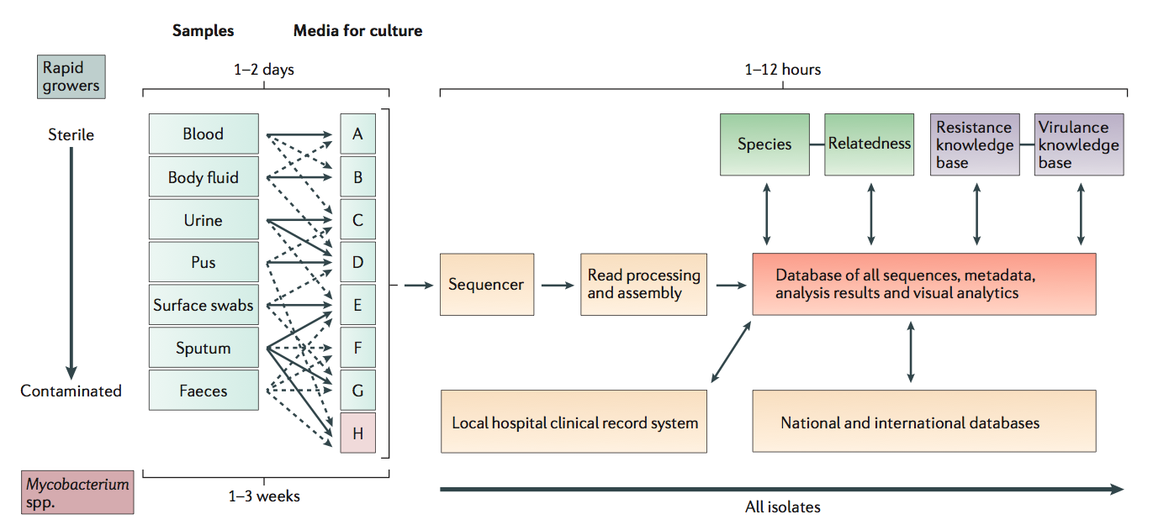
Digital microbiology?
Didelot, Crook et al. PMID 22868263

Slide 14
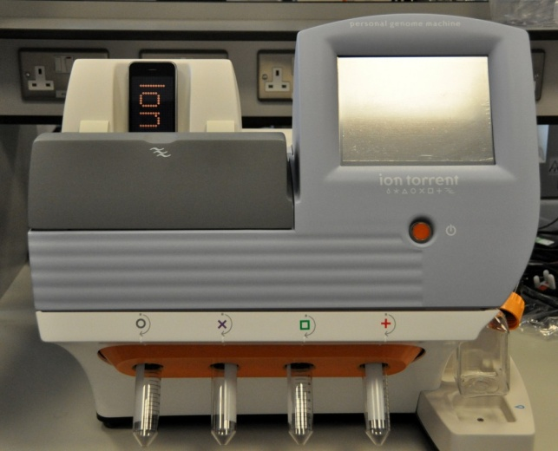
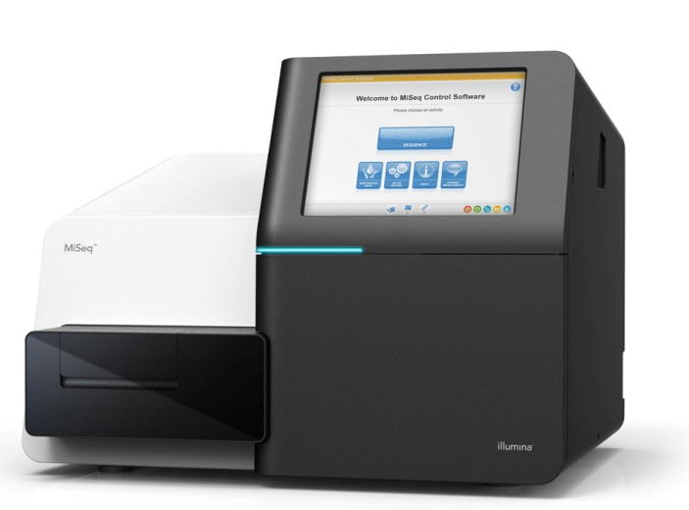
A New Opportunity: High-Throughput Sequencing
Brings the advantages of
open-endedness (revealing the “unknown unknowns”),
universal applicability
ultimate in resolution
Bench-top sequencing platforms now generate data sufficiently quickly and cheaply to have an impact on real-world clinical and epidemiological problems
Mark Pallen

Slide 15
Costs
Application | Library Cost | Sequencing cost
Whole human genome (30x coverage) | £25 | £1000 - £5000
Whole bacterial genome (Illumina) | £25 | £25
16S phylogenetic profiling | £2 | £1 - 10
Metagenome (2Gb per sample) | £20 | £750

Slide 16
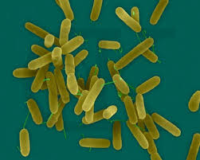
Whole genome sequencing to track the spread of Pseudomonas aeruginosa within a burns unit
Gram negative bacterium
Opportunistic pathogen in burns patients
Infection can lead to graft breakdown and sepsis
Isolated from 30% of burns patients
Nicola Cumley
Notes:
Pseudomonas aeruginosa is a ubiquitous environmental gram negative bacterium. However in patients with sever burns infection with the organism can lead to graft breakdown and loss and sepsis. With obvious consequences to mortality and morbidity and increased hospital stay.
A previous study in the burns unit has shown that approximately 30% of patients will become COLONISED/INFECTED with pseudomonas aeruginosa during their stay on the unit. Other studies have shown rates of XX and XX
The source of the organism is unclear

Slide 17
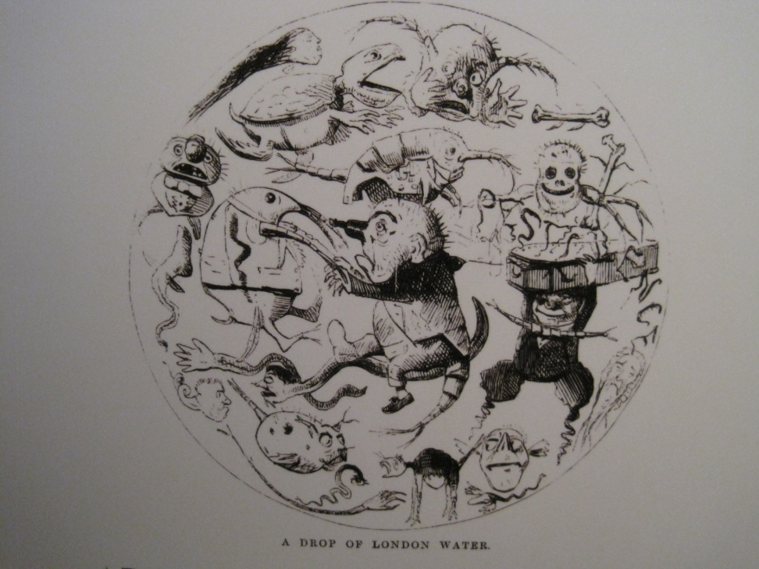
Water as a potential source of Pseudomonas
Sources of Pseudomonas infection
Endogenous
Cross infection
WATER
Outbreaks linked to contaminated water
Showering important part of burns care
Notes:
It is not clear cut what the source of patients pseudomonas infection is
Previous studies have shown that psuedomonas infection can be from endogenous sources, that is the patients own flora
Cross infection on the ward, with healthcare workers hands being shown to be contaminated with the same strain
Or the most likely suspect water.
Pseudomonas is an ubiquitous environmental organism and can from biofilms on fittings. Recent high profile ourtbreaks on neonatal units have been linked to waste water and taps.
This has lead to national guidelines for routine sampling of hospital water being published in February this year.

Slide 18
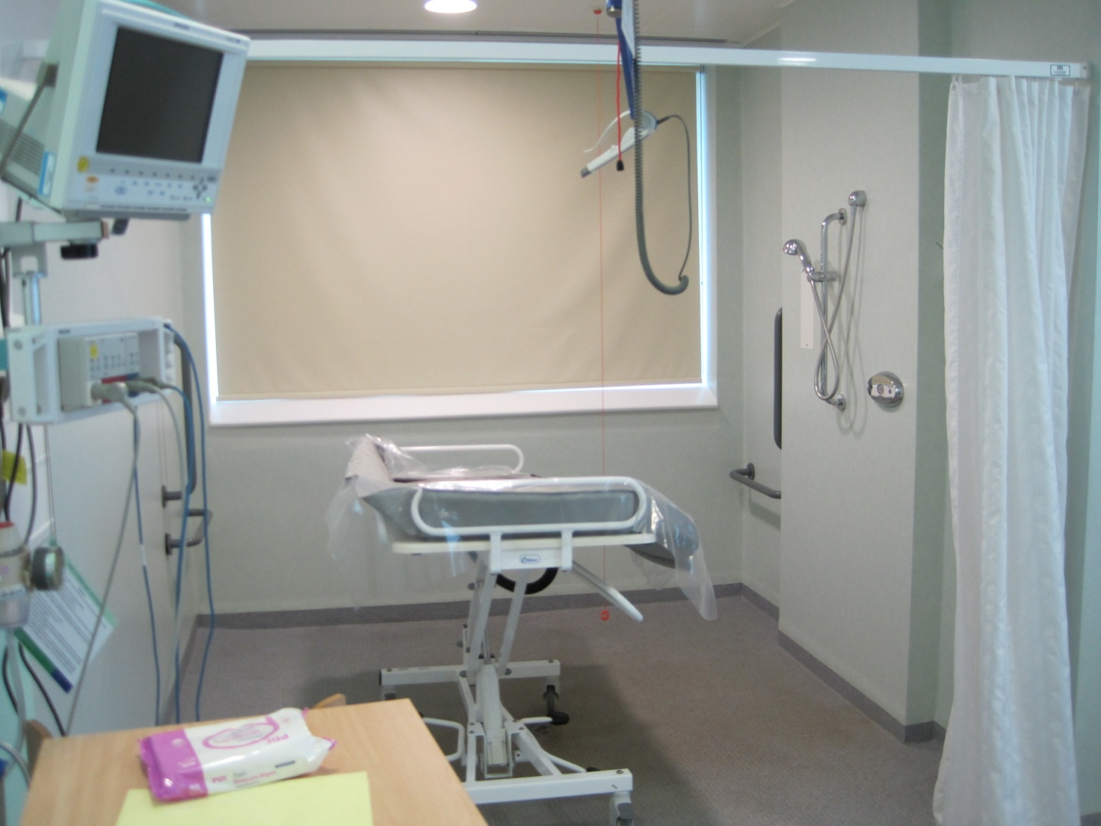
Notes:
Water is an especially important aspect to burns care as part of the treatment is to have dressing changes and skin removal under the shower. The burns unit at the QE has several shock rooms in which are walk in shower areas.
The invidual patients rooms have a walk in shower area with either a shower bed or trolly where the patient can be transferered to to have dressing changes and wound cleaned. Thease rooms are also kept very warm, up to 37º perfect incubation temperature for bugs!
Pseudomonas oubreaks have previously been linked to hydrothreapy baths in the early 90’s.

Slide 19
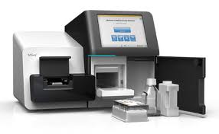
Study: Surveillance in burns patients
Aim: to determine relative contribution of:
Endogenous infection
Cross-infection
The water supply
Use whole-genome sequencing for greatest typing resolution and to infer links between positive isolates
Notes:
Protocol drawn up to try to establish if the cause of infection is endogenous, the patient comes in with it.
If the organism is residing in the environment (unclean)
If cross infection around the ward is a problem (do all the patients have the same strain)
If the organism is in the water
The organism then had there whole genome sequenced
To try and drill down the source of pseudomonas we are utilizing the ability to now sequences a whole organisms genome at a reasonable cost and in under a week timescale.
Sequencing the whole genome allows us to better identify possible transmission patterns than using the typing methods available, it allows us to learn more about the organisms pathogenicity and physiology.
The problem of pseudomonas in burns patients has not yet been investigated using this technique.

Slide 20
Collection of isolates of Pseudomonas aeruginosa
Screening on admission
>7% burns
Wound swabs, stool and Urine for microbiology
Stool for molecular testing
Environmental sampling of the patients room and shower water
Recruited positive patients
Wound swabs at each dressing change
Environmental sampling
Swabs/tissue for metagenomic analysis
Environmental sampling on discharge
Notes:
Patients with greater than 7% burns are eligible to be included in the trial
On admission they will have a urine sample, wound swabs and a stool sent to microbiology for specific pseudomonas culture
A stool sample is also sent for molecular testing
Initial environmental samples are taken from surfaces within the room including shower areas, patient touch areas and the bed, to see if the area is clean.
Patients are routinely being sampled for microbiology as part of their care.
If on these swabs a patient becomes positive for pseudomonas they then have increased numbers of wound swabs sent specifically for pseudomonas culture
Environmental samples are again re taken and taken on discharge post cleaning
Swabs are also sent for molecular testing where all bacterial DNA in the sample will be sequenced and analysed.
This continues until the patient is discharged.
Any pseudomonas that grows is identified using standard methods and the DNA extracted and processed for sequencing

Slide 21
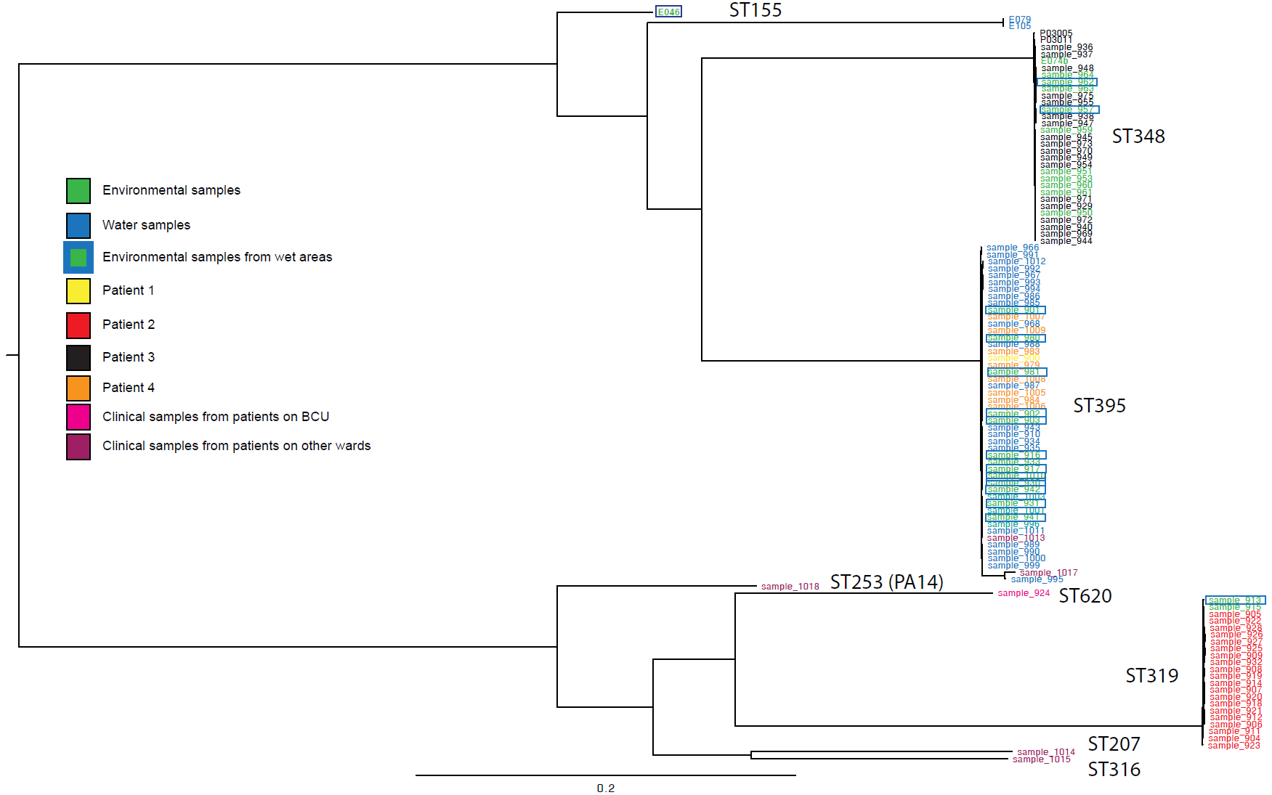
Isolates from the study fall into three main sequence types
ST348
ST395
ST319
Notes:
This is the phylogenetic tree of all the isolates that have been collected.
I appreciate it is too small to read so I will just highlight to you the colours and the key features.
There are several different clusters each representing an MLST sequence type.
(MLST type is assigned based on the sequence of 7 housekeeping genes, the sequences of these are compared to sequences published in a massive international database, this allows the strains to be given a number that can be compared to strains anywhere)
Most of the pseudomonas isolates from patients within the trial fall into three groups ST348, ST319 and ST395
ST348 contains isolates from patient 1 and the environment, ST319 contains patient and environmental isolates and ST395 contains most of the isolates obtained from water, showers and taps, most of the environmental isolates and the isolates from patients 1 and 4.

Slide 22
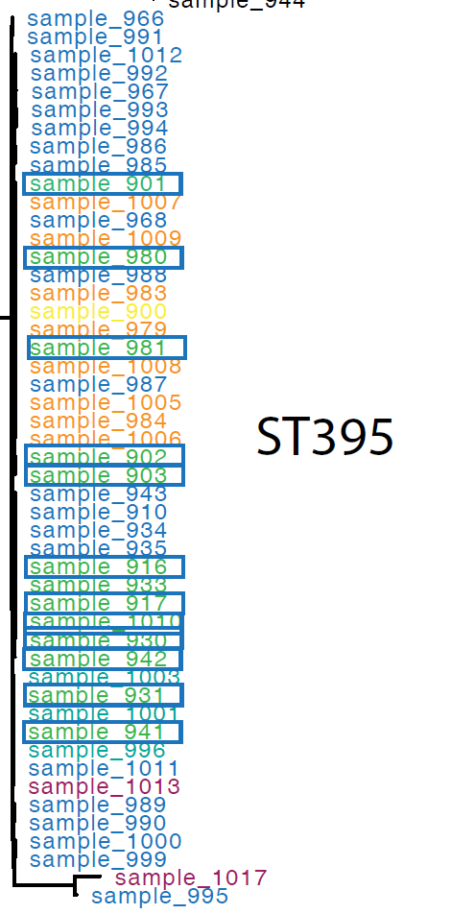

Whole genome sequencing allows for deeper resolution of sequence types
Notes:
What having the whole genome sequence allows us to do is to zoom in on MLST types and use all the genetic information rather than the 7 genes used for MLST which are stable and so will not represent recent changes in the organism.
The way that this is done is to compare the genomes within the group for individual base changes, or single nucleotide polymorphisms (SNP’s)

Slide 23
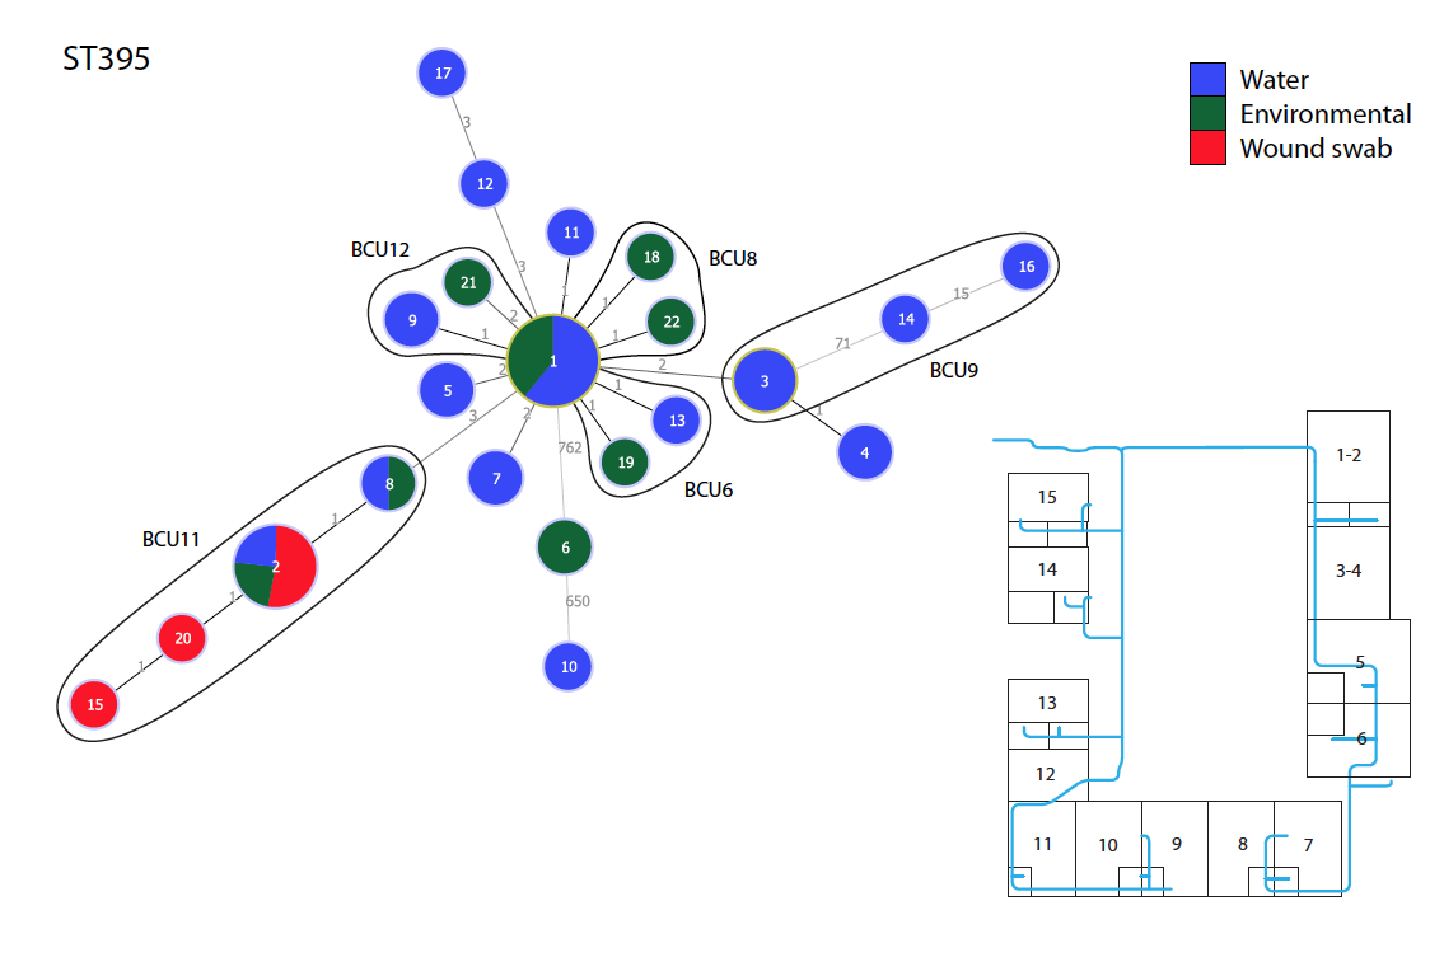
Water isolates and patient isolates are indistinguishable by SNP typing
Notes:
This is a detailed look at the ST395 group. Each branch represents one nucleotide difference. You can see that although these all type as the same sequence types they are not identical.
Thease although small, only one base change in XXX but are thought to represent changes in the organism over time and be significant.
Isolates from the water and associated environments are no longer identical but forming separate groups.
The really interesting thing here and what we are really look for is that the patient isolates are indistinguishable in patient 1 and patient 2 from the water isolates that have come from the showers within that patients room.
The fact that they are identical gives strong evidence that the patient has been contaminated by the water from the room.

Slide 24
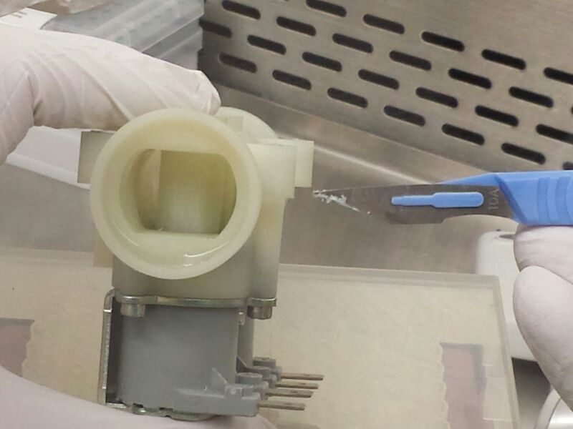

Slide 25
Metagenomics protocol
Nextera XT protocol NOT according to manufacturer’s protocols
<1ng DNA input
1 MiSeq run (V3, 2x300)
Short fragments returned
P. aeruginosa at ~5x coverage

Slide 26
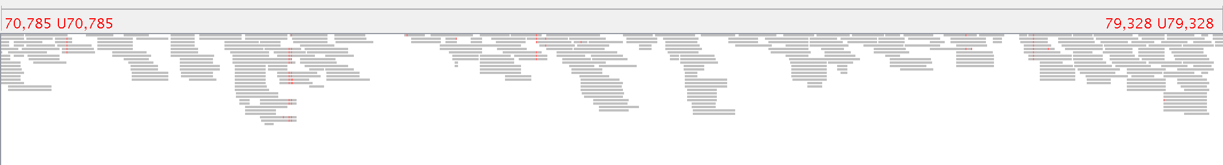
Alignment to reference genome

Slide 27
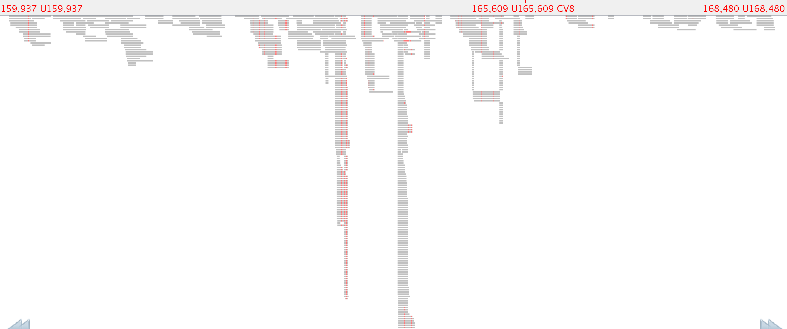

Slide 28
SNP typing pipeline
Alignment of complete genomes to reference
Trusted set of high quality SNPs
ML tree (FastTree)
Call variants from low coverage data
Place on reference tree with pplacer

Slide 29
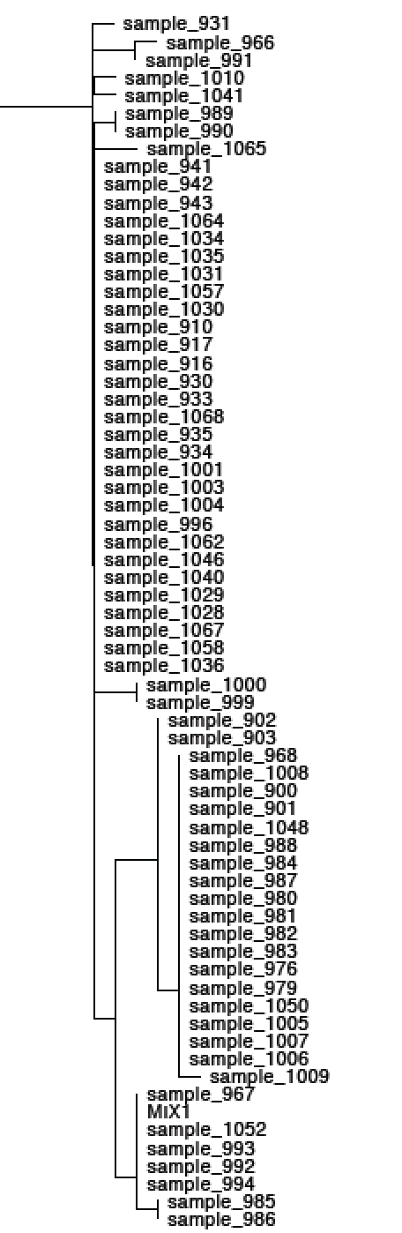
SNP typing from metagenomes
967 Shower BCU 9
1052 Shower BCU 9
992 Tap BCU 9
993 Shower BCU 9
994 Shower BCU 9

Slide 30

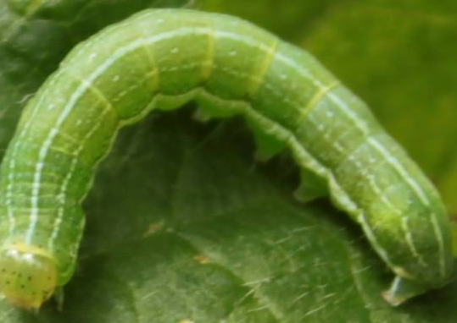

Slide 31
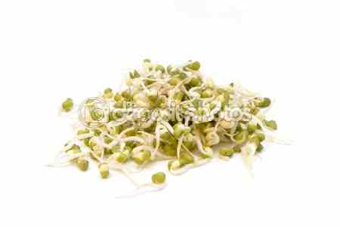
German E. coli O104:H4 outbreak aka SPROUTBREAK
May-July 2011
>4000 cases, >50 deaths in Germany
Link to sprouting seeds
Increased risk of haemolytic-uraemic syndrome (>25%)
Females particularly at risk
Notes:
Insert the graph

Slide 32
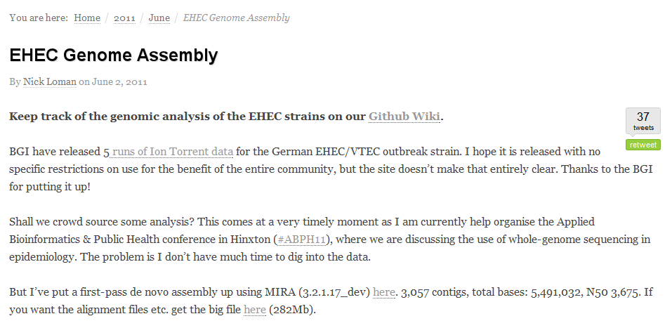
Crowd-sourcing the genome

Slide 33
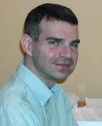
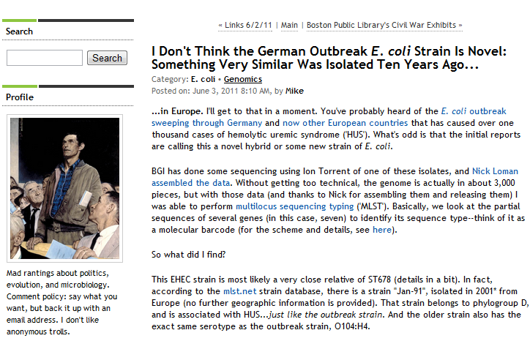
Crowd-sourcing the genome

Slide 34
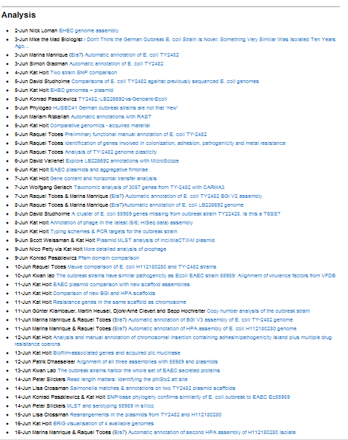




Slide 35
Crowd-sourcing the genome
AAF cluster
WrbA Stx2 site
PCR targets
Assembly
https://github.com/ehec-outbreak-crowdsourced/BGI-data-analysis

Slide 36
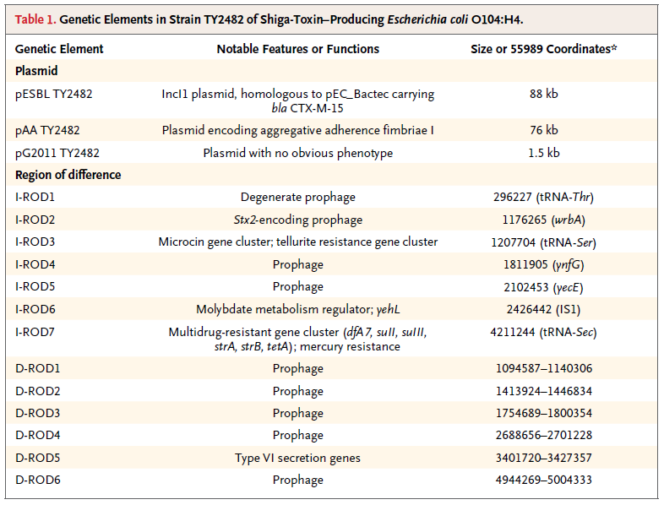
Rohde et al. DOI: 10.1056/NEJMoa1107643

Slide 37
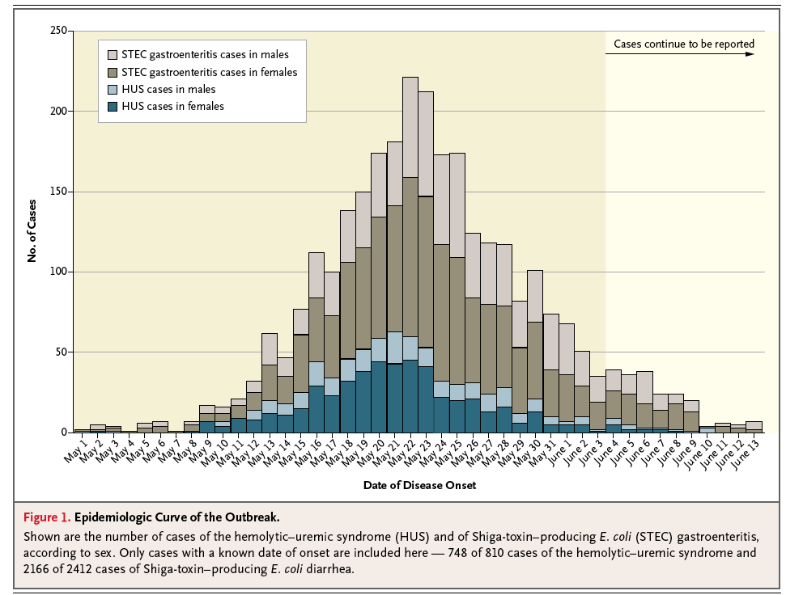
Genome data released,
crowd-sourcing begins
Frank et al DOI: 10.1056/NEJMoa1106483

Slide 38
Digital microbiology?
?

Slide 39
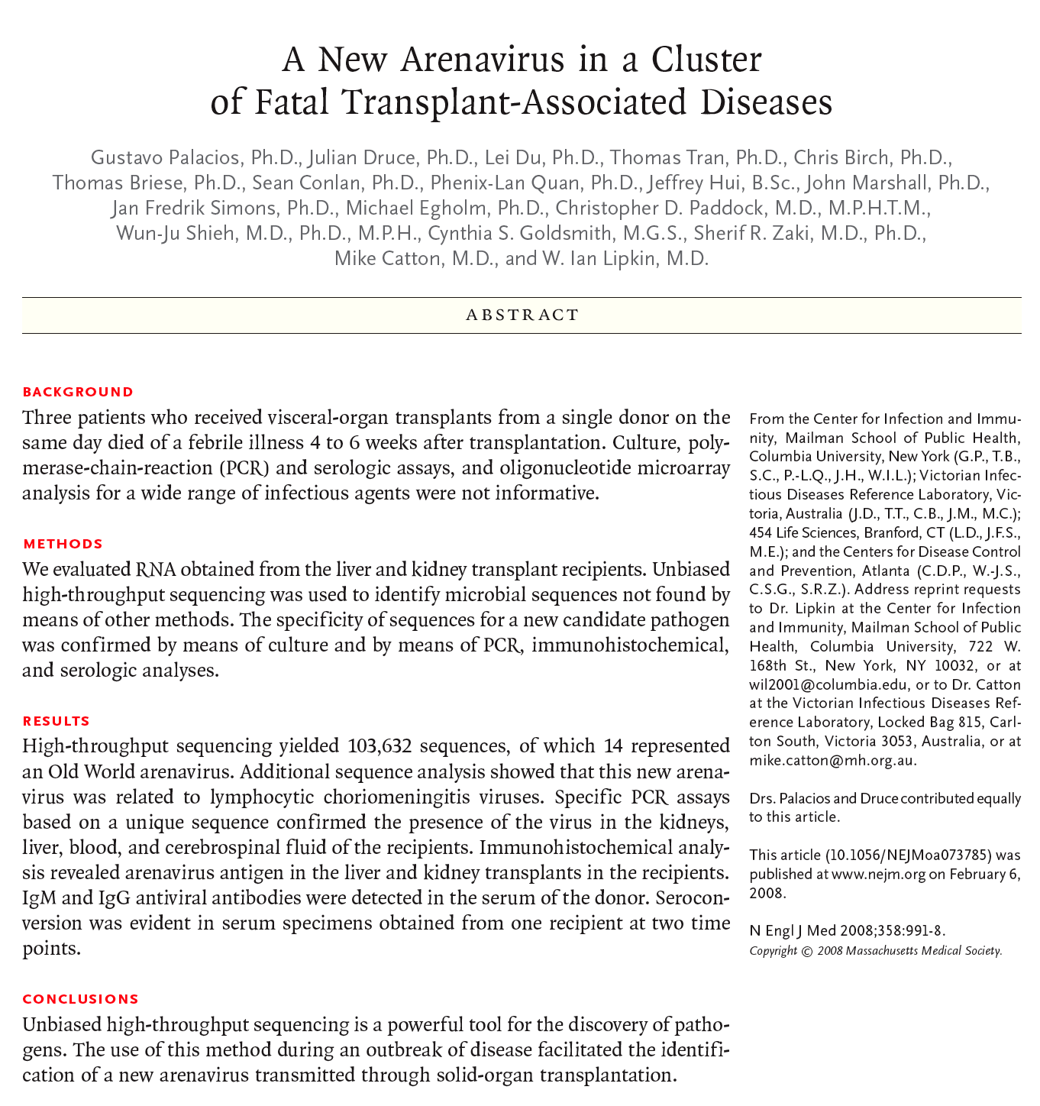
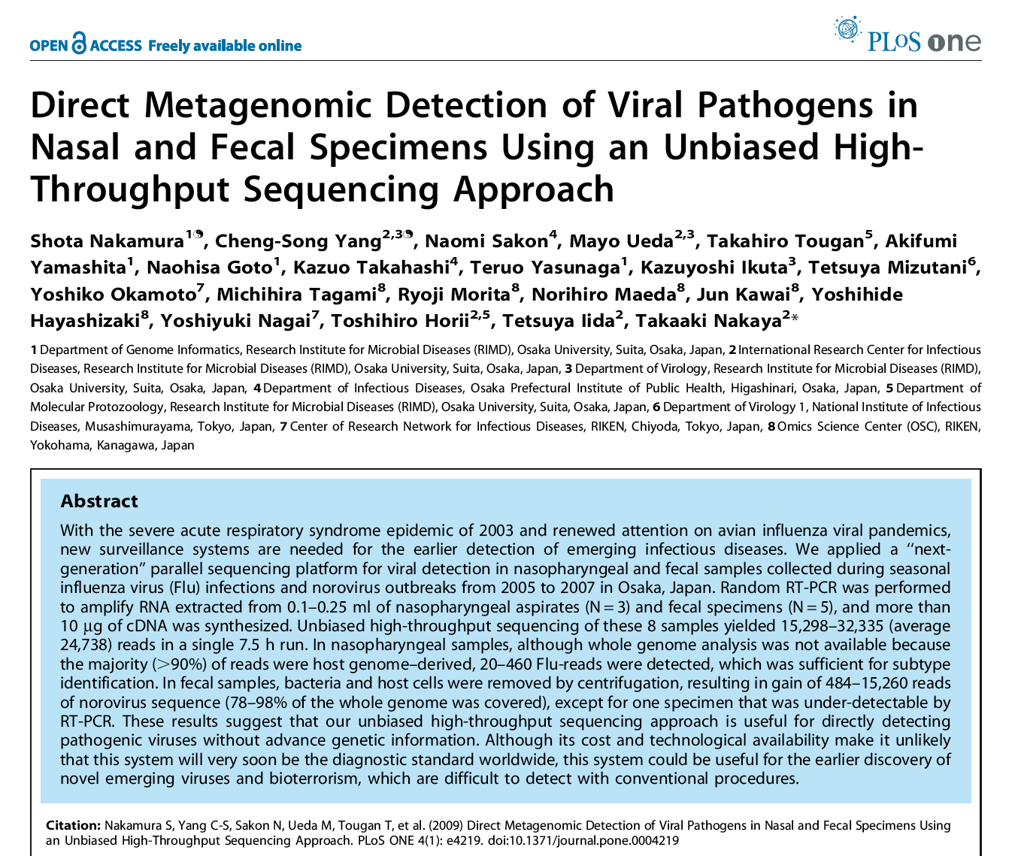
Clinical metagenomics: Pathogen discovery
Notes:
3 patients who received organs from the same donor died. Al conventional lab tests failed to find a cause. 454 sequencing or RNA from liver & kidney found 14 reads (of 100,000) which resembled arenavirus, confirmed later to be the likely cause of death.

Slide 40
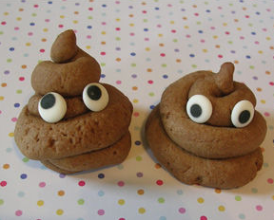
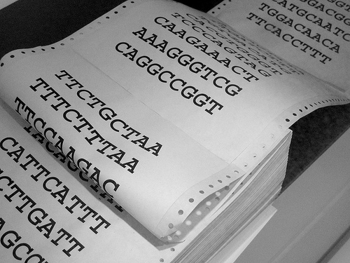

Diagnostic metagenomics
17 million reads / >2 gigabases per sample
STEC
45 samples
Non-STEC
34 patients
C. diff, S. enterica, C. jejuni
Notes:
Why Metagenomics not 16S?

Slide 41
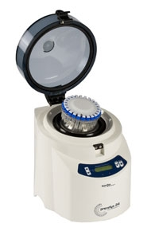
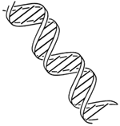
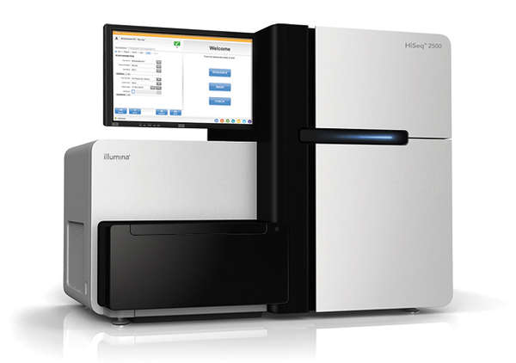
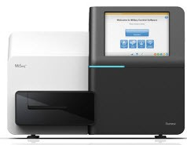
1) Sample preparation (4.5 hours)
DNA fragmentation, tagging and barcoding
Stool sample
Tissue homogenizer
DNA extraction
2) Sequencing (27-40 hours)
3) Bioinformatics analysis (<24 hours of 32-core server time)
Align sequences to human genome and discard those that map to it
Cluster EGTs based on read-pair information
Assemble microbial sequences into environmental gene tags (EGTS)
Cluster EGTs based on abundance information
HiSeq, 40 hours
Taxonomic assignment of EGTs through homology
Outbreak-associated genomes
Alignment of EGTS from outbreak samples and healthy samples to assembly
MiSeq, 27 hours
Diagnostic and epidemiological conclusions
Subtract EGTs present in healthy samples from disease samples
Paired 150 base reads

Slide 42
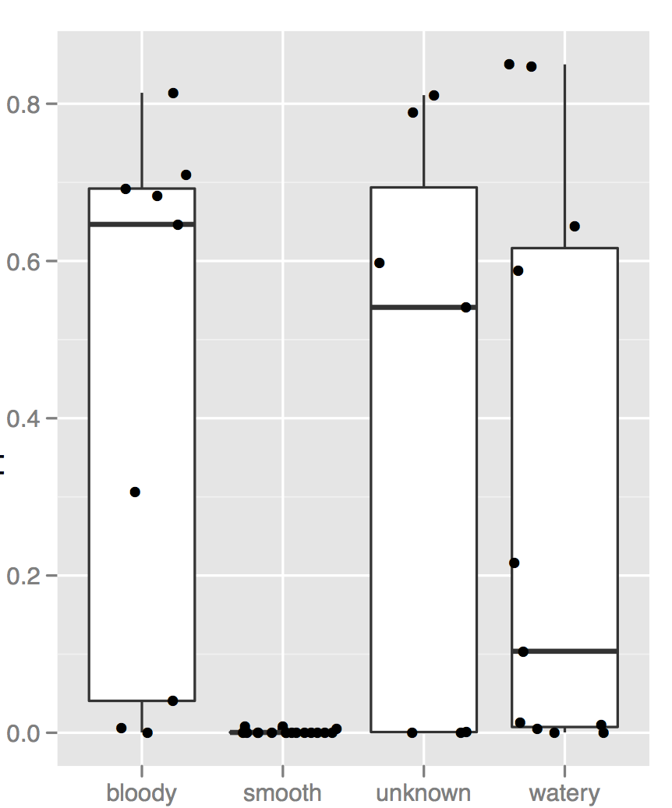
Human “contamination”
Fraction mapped reads
Stool appearance

Slide 43
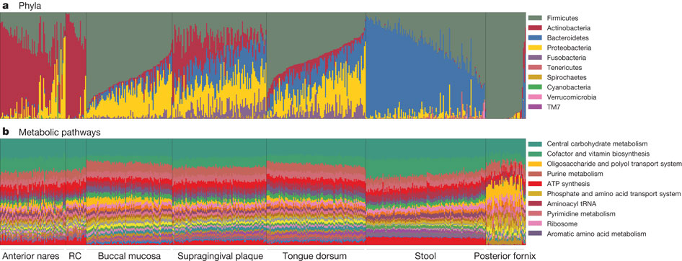
Healthy human microbiome
The Human Microbiome Project Consortium
PMID: 22699609

Slide 44
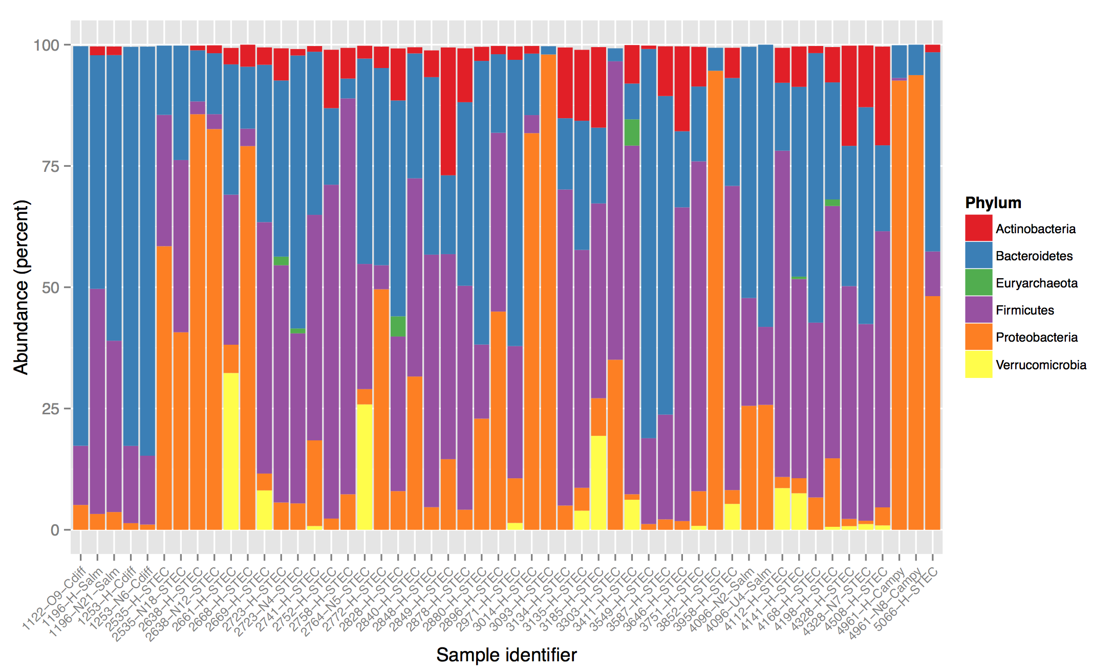
Metagenomics: phylogenetic profiling
Notes:
Why Metagenomics not 16S?
----- Meeting Notes (10/12/2012 10:42) -----
invert that

Slide 45
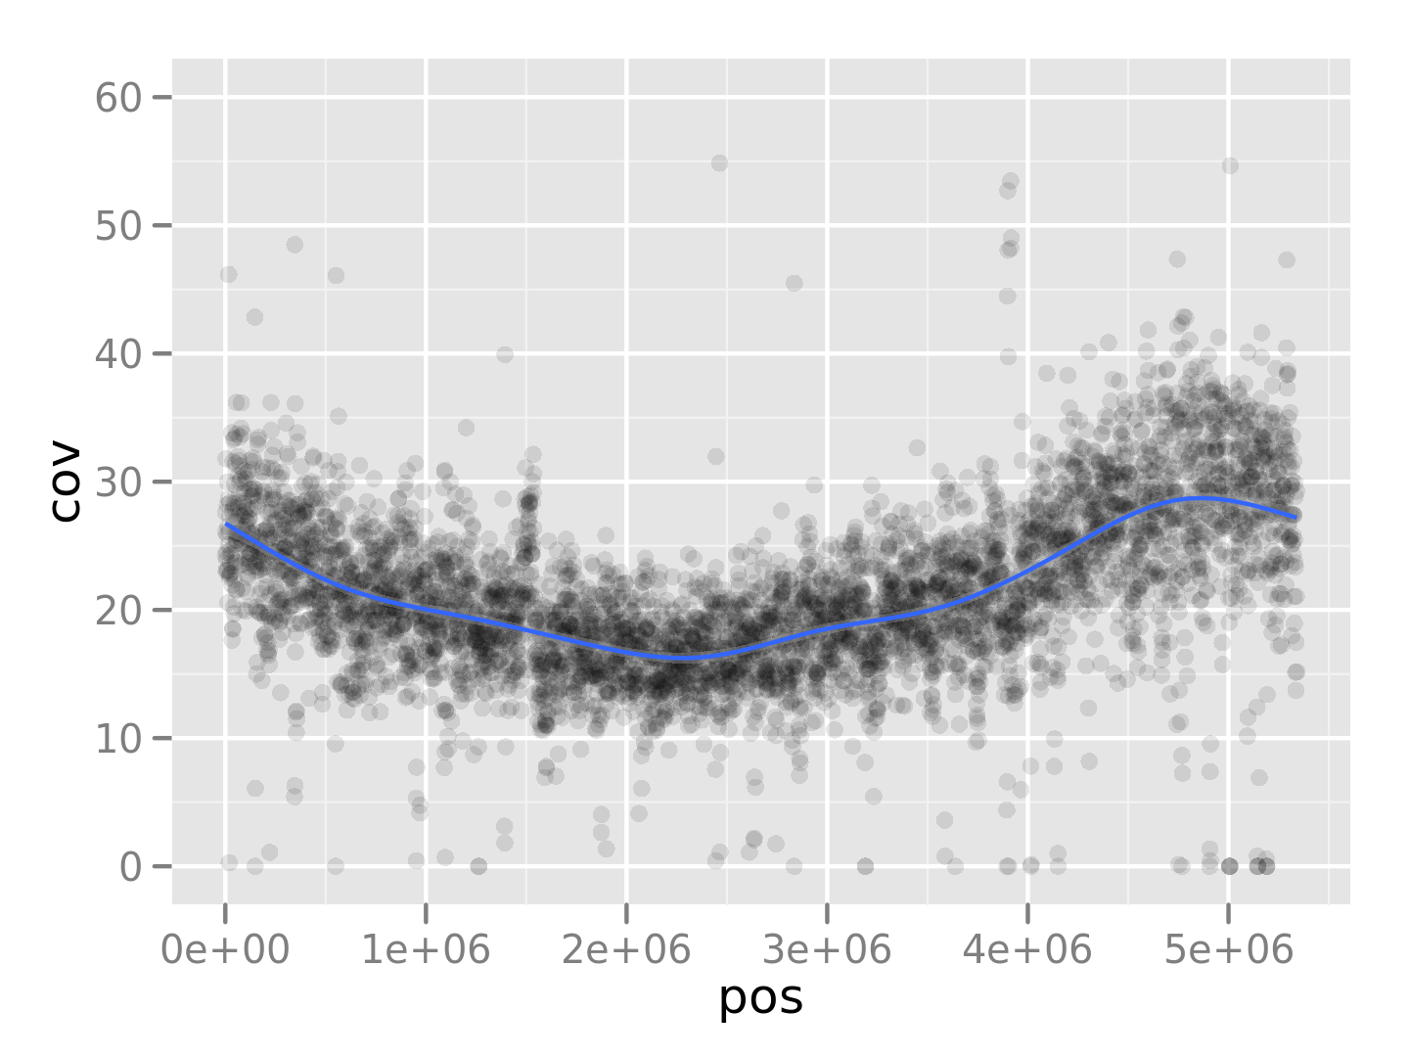
STEC genome coverage plot
Shiga-toxin encoding phage
Notes:
1De novo assembly with digital normalization?

Slide 46
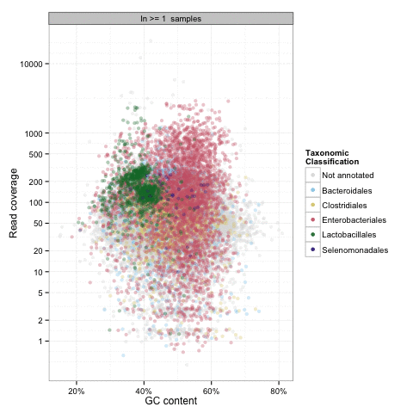

Pathogen Discovery: Minus healthy controls
MetaHIT

Slide 47
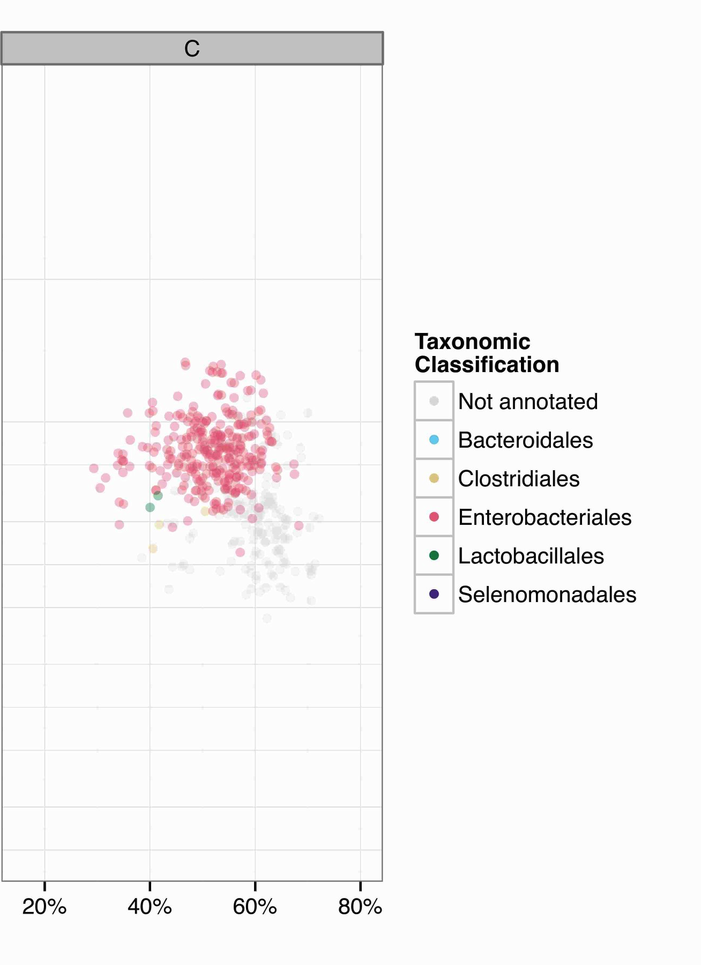
Pathogen discovery
Shiga-toxin encoding phage genes
O-antigen determining genes
pAA and pESBL specific sequences
Motivations for CONCOCT:
Unsupervised version?
Can we extract all the genomes?
CONCOCT: Chris Quince, Anders Andersson

Slide 48
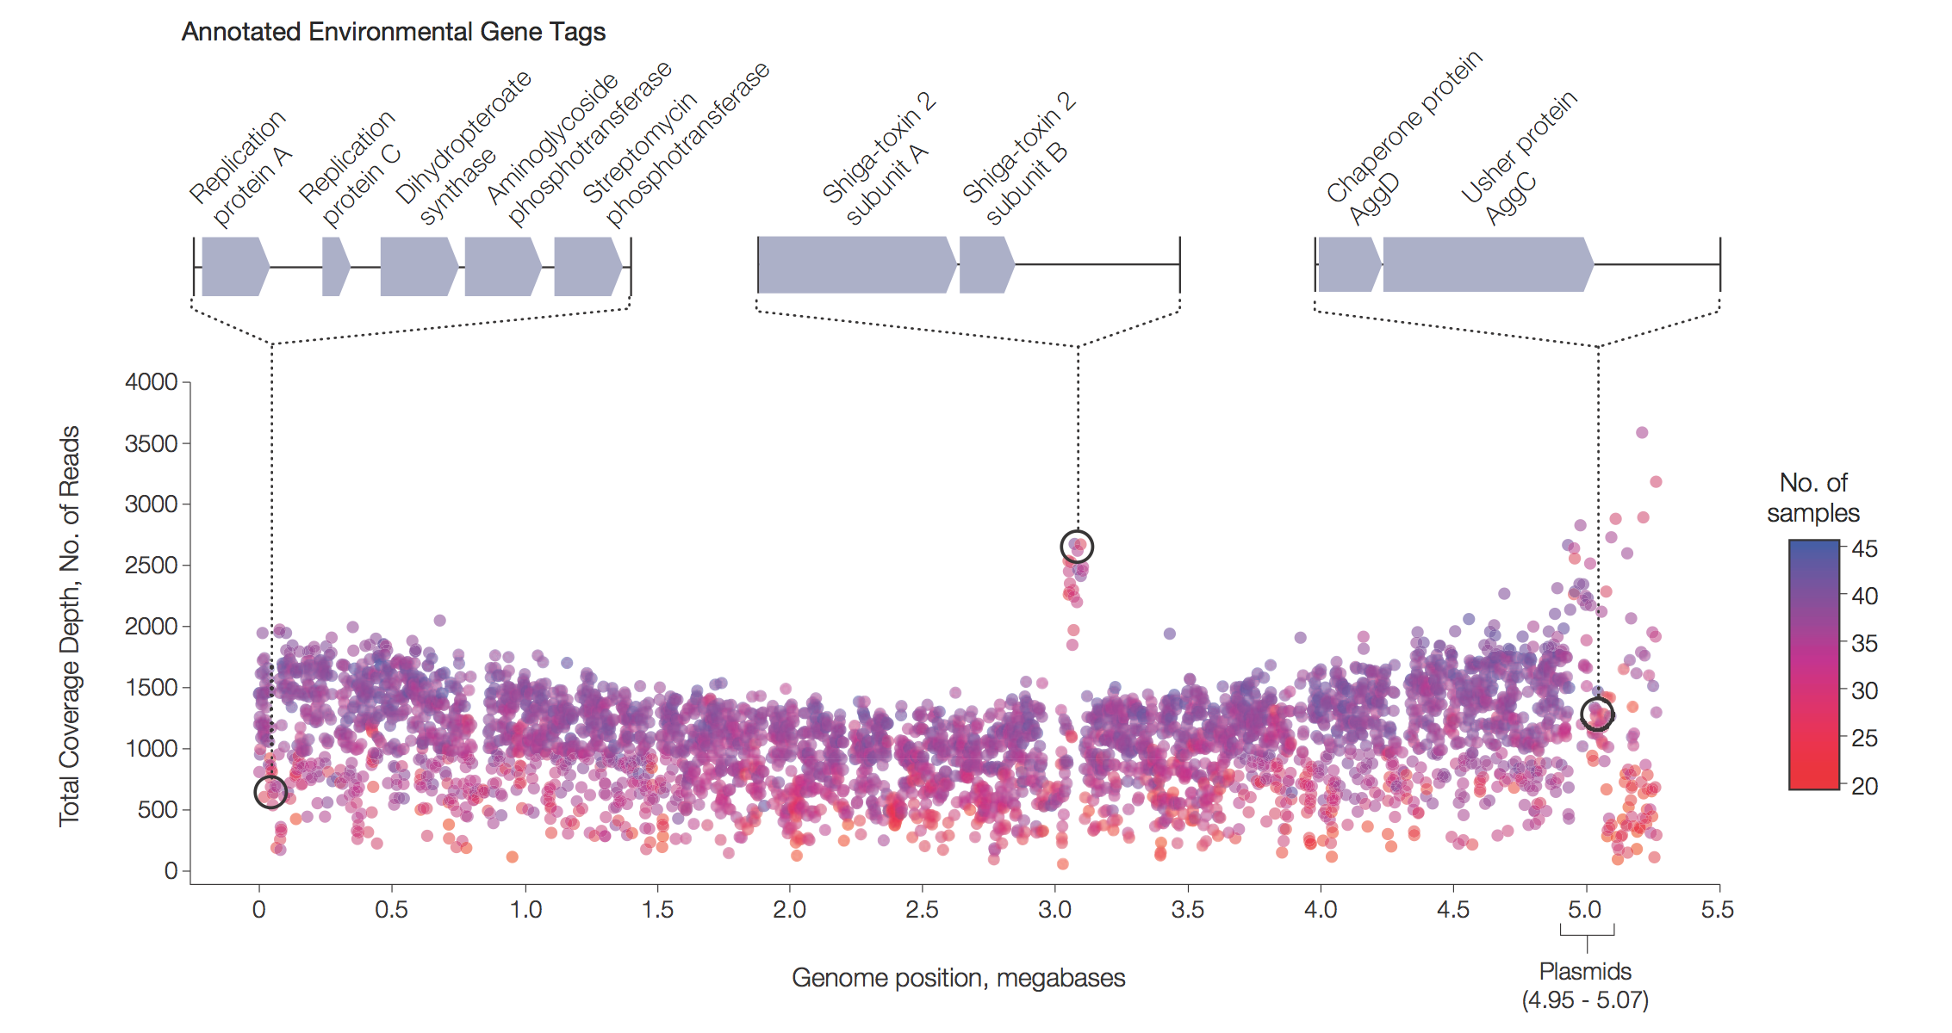
E. coli O104:H4 genome reconstruction
Loman et al. doi: 10.1001/jama.2013.3231.

Slide 49
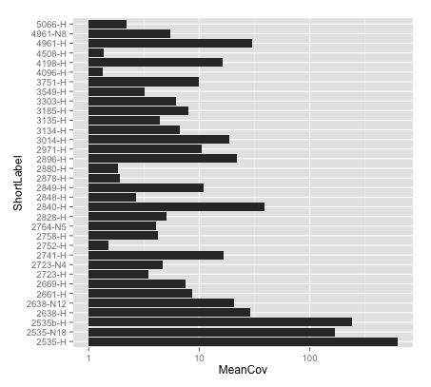
Getting the diagnosis: STEC genome reconstruction
STEC genome recovered at >10x coverage: 10/40
STEC genome recovered at >1x coverage: 26/40
Shiga toxin fragments recovered: 27/40
Detected STEC genome in 6 samples which were ELISA negative
Notes:
Why Metagenomics not 16S?

Slide 50
Shiga-toxin encoding phage: Copy number variation

Slide 51
Detection of important virulence genes
Flagellin (H-antigen)
MLST
Correct H antigen detected in 17/40
No H antigen detected in 18/40
Mixtures of antigens detected in 3/40
ST678 profile unambiguously detected in 9/40
Mixture of profiles detected in 5/40
The rest either partial or absent profiles

Slide 52
Non-STEC genome reconstructions
Clostridium difficile toxin sequences detected (2/2)
Campylobacter jejuni toxin sequences detected
Salmonella enterica sequences detected (1/2)
Emerging human pathogen Campylobacter concisus detected

Slide 53
Experimental considerations

Slide 54
Tissue metagenomics: in the dark
A case of chronic osteomyelitis
Surgical debridement and reconstruction of a compound fracture wound at the left tibia
Reconstruction was carried out using a radial forearm free flap
Initial injury 5 years ago
5 tissue samples from operation on a single MiSeq run
Extracted with Stratec-RTP Bacterial DNA Mini kit.
Notes:
I have attached our lab protocol for processing the samples. The sonication fluids from P01 have actually been lost due to human error. Looking at Nicola’s lab book, the bone extraction for P01 (28.2.13) was done using Stratec-RTP Bacterial DNA Mini kit. The protocol used was 5: Isolation of bacterial DNA from tissue biopsies (Attached). A modification she used was adding half a tube of Lysis Matrix B (Ref no. 1116911100) which I think she got from Robin’s lab and vortexing it for 2 mins. Can bring down her lab book to the meeting on Monday.

Slide 55
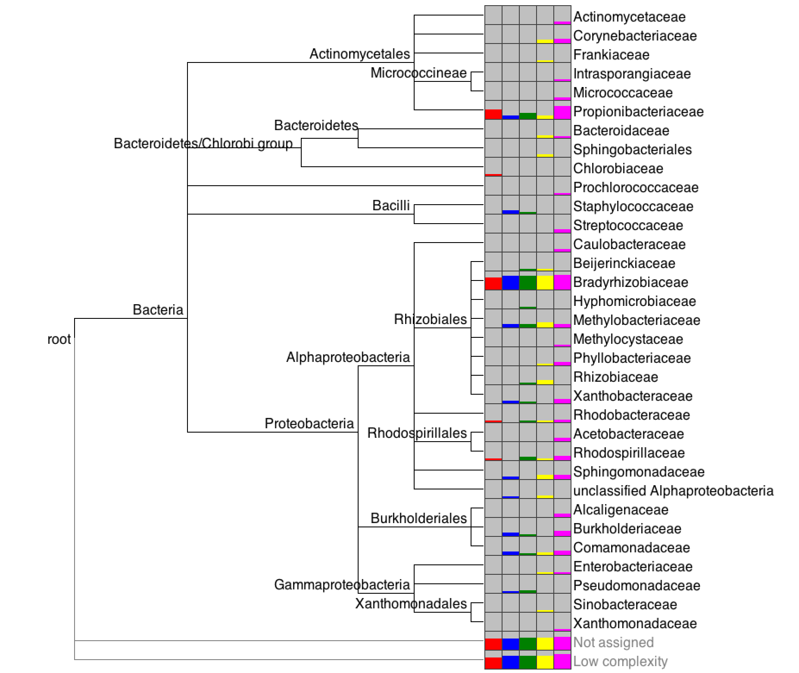
Chronic osteomyelitis
Notes:
Fix score remove archaea
New version without controls

Slide 56
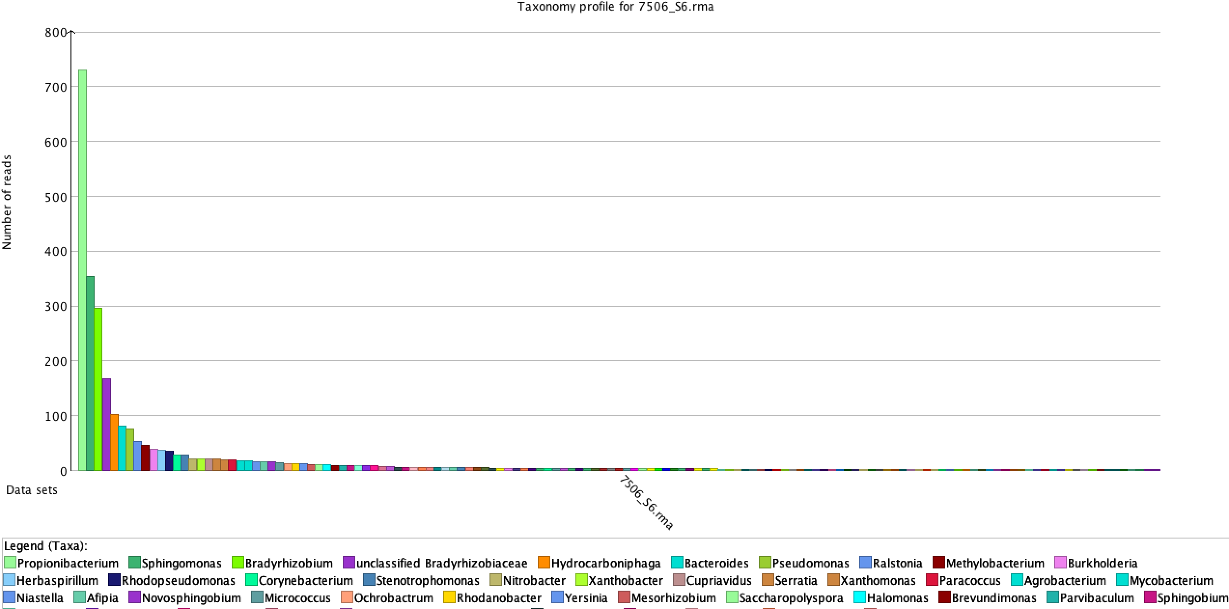
Negative control!
12358 reads

Slide 57
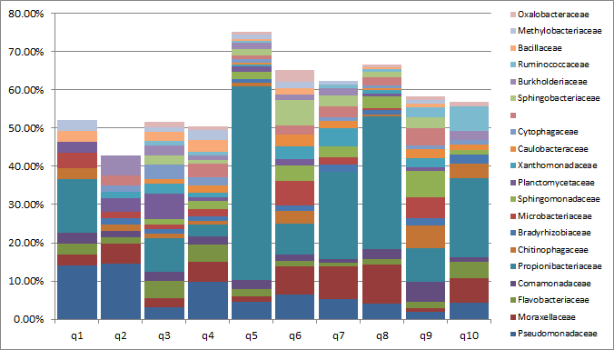
Kitome: QIAGEN Stool Kit
Zannah Salter
Notes:
Pseudomonas, p. acnes, moraxellaceae sphingo

Slide 58
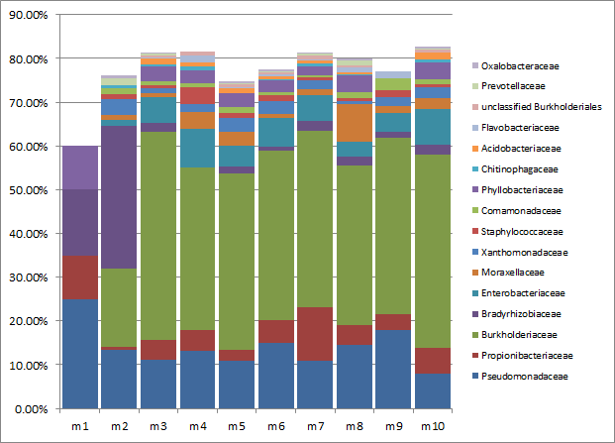
Kitome: MPBio
Zannah Salter

Slide 59
Consider contamination
Environmental DNA or bacteria themselves can be introduced at many points:
Sample collection
DNA extraction
PCR reagents
Lab contamination

Slide 60
Just throw more reads?
5 reads in 5,000,000
1 read in 1,000,000
Staph genome ~2Mb
30x coverage required (?)
240 billion reads required
6 billion reads per HiSeq 2500 run
40 HiSeq runs
Cost of ~£500,000
Oh dear!

Slide 61
Background depletion
Differential lysis
Human cells fragile
Eukaryotic DNA is methylated
MoLysis
NEB Microbiome Kit
MEDIP
… what about microbial eukaryotes? ☹

Slide 62

MolYsis™
http://www.molzym.com/products/dna-isolation-products/pathogen-dna-molysis/molysis-technology.html

Slide 63


NEBNext
https://www.neb.com/products/e2612-nebnext-microbiome-dna-enrichment-kit

Slide 64

Justin O’Grady, Josh Quick, Szymon Calus

Slide 65

Microbial enrichment
(Micro)culture(omics)!
Also may introduce bias
Lose quantitative information
PCR: 16S / marker genes
Poor species level discrimination, no genome-scale information
Oligonucleotide probe capture
May be practical solution: Restricts to known knowns
Antibody capture
E.g. Immunomagnetic separation (Chlamydia)
Cell sorting & whole-genome amplification

Slide 66

Single cell bacterial genomics
McLean et al. PMID:23564253

Slide 67
Experimental design questions
How many samples for statistical power?
Replicated design? Biological or technical replicates?
Extraction method(s) ?
Level of background contamination?
Necessary controls
Longitudinal and/or cross-sectional?
Sequencing technology: read length
How many reads?

Slide 68
Taxonomic and functional assignments
Read-based
Environmental gene tag or contig-based (from assembly)
Pathway-based
Genome-based (from a great assembly)

Slide 69

Adam Bazinet, http://www.biomedcentral.com/1471-2105/13/92

Slide 71
Similarity methods
Choice of aligner determines speed
Can make inference from a single read
Can work in translated BLAST mode
Very sensitive
BLAST is very slow!
Specificity can be low with naïve approach
Many reads are taxonomically uninformative or taxonomically misleading

Slide 72
Aligners
BLAST
RAPSearch2
LAST
BWA/Bowtie (in 6-frames with PAUDA)

Slide 73

Caveat emptor: Similarity methods
MG-RAST

Slide 74

MEGAN

Slide 75


Slide 76

MEGAN
Huson et al. 10.1101/gr.5969107

Slide 77

Huson et al. 10.1101/gr.5969107

Slide 78

Huson et al. 10.1101/gr.5969107

Slide 80
Phylogenetic methods
Accurate
Give measurement of uncertainty
Can use multiple conserved marker genes (~40 common)
Slow
Dependent on quality and completeness of reference tree
Prokaryo-centric

Slide 81

Stark et al. 10.1186/1471-2164-11-461

Slide 82


Slide 83

Twitter can be useful?!

Slide 84




Slide 85
Phylogenetic assignment
mOTUs
Phylosift
MLTreeMap

Slide 87

Metaphlan
Lineage-specific marker genes
Hybrid similarity and phylogenetic method
Segata et al. 10.1038/nmeth.2066

Slide 88


Slide 89
Functional assignments
SEED
COGs
EggNOG
KEGG

Slide 90

HUMANn
Abubaker et al. 10.1371/journal.pcbi.1002358

Slide 91

LEfSe

Slide 92
Metagenomics assembly
A great way of compressing your dataset
Fundamental unit of analysis are now contigs (environmental gene tags)
Assignment methods can be used as before (+/- gene prediction)
Coverage information can be restored through mapping reads to assembly

Slide 93
Metagenomics assembly: issues
Large datasets may overwhelm available RAM
Contigs may represent chimeras of multiple, related species or strains
Low coverage organisms won’t assemble
http://davis-assembly-masterclass-2013.readthedocs.org/en/latest/outputs/opinionated-guide.html

Slide 94
Opinionated guide to assembly
Metagenome assembly:
Ray
Velvet
IBDA-UD
(Optional) digital normalization
http://davis-assembly-masterclass-2013.readthedocs.org/en/latest/outputs/opinionated-guide.html

Slide 95

Genome binning
http://madsalbertsen.github.io/multi-metagenome/

Slide 96
CONCOCT: Clustering cONtigs on COverage and ComposiTion
Data pre-processing:
Perform coassembly across all samples
Map reads back to contigs to get mean coverage of contig in each sample
Generate k-mer frequency vector for each contig
Join vectors and log transform
PCA
Segata et al. doi:10.1186/gb-2011-12-6-r60

Slide 97


Oxford Nanopore: Hope or hype?
Strand sequencing
Biologically modified nanopore
Tri-nucleotides detected
Theoretically unlimited read length
Sequence directly without extensive sample preparation
MinIon: 150mb/hour for up to 6 hours for $900 – disposable
GridIon: rack-mounted sequencer with 2000-8000 nanopores
MinION access programme starting end November
http://pathogenomics.bham.ac.uk/blog/2013/10/the-oxford-nanopore-golden-ticket/
Notes:
Nanopore have announced a strand sequencing method, made possible by a heavily modified biological nanopore and an industrially-fabricated polymer
DNA passes through the nanopore and tri-nucleotides in contact with the pore are detected through electrochemistry
Demonstrated 2x50kb sense & anti-sense of same molecules (lambda phage) – no theoretical read length limit
Can sequence direct from blood without need for sample preparation
Two products announced:
MinIon – USB disposable sequencer for ~ $900 has 512 nanopores – target 150mb/hour
MinIon can run at 120-1000 bases/minute per pore for up to 6 hours
GridIon – two versions of rack-mountable sequencer with 2000 nanopores (2nd half 2012), 8000 nanopores (2013)
GridIons can be racked in parallel, 20 could do a whole human genome in 15 minutes
Each GridIon can do “tens of gigabases” over 24 hours
Both machines commercially available 2nd half 2012
Sequencing can be paused, sample recovered, replaced, started again
Accuracy is 96%, errors are deletions, error profile will improve through software

Slide 98

SHTSeq™
http://pathogenomics.bham.ac.uk/blog/2012/02/a-new-sequencing-technology-enters-the-ring-shtseqtm/

Slide 99
Metagenomics - Questions
What are the best ways to address getting representation of bacteria, viruses, fungi and others? Techniques for doing so?
Thoughts on the use of physical enrichment techniques to isolate microbe of interest rather than traditional metagenomic sequencing?
What are the best bioinformatic software packages and pipelines for functional analysis?
What are the best analysis pipelines for full viral sequencing to detect whether mutations are true or not? Comparing closely related taxa?
As an initial approach, should one try 16s sequencing prior to shotgun sequencing if interested in bacteria (or 18s/ITS1 for Fungi)? Which region?
Shotgun metagenomics versus single cell genomics - for high diversity samples is a shift toward single cell beneficial?
Any expertise in microbial or viral single cell genomics? Software suggestions for assembling viral genomes and large scale microbial genome comparison?
Metatranscriptomics versus metagenomics?
Benefits/disadvantages of each?
Best tools for de novo assembly and annotation
Most useful databases for metagenomics
Thoughts on combining methodologies - i.e. PacBio sequencing for scaffolding and Illumina/454 for depth/decreased error?

Slide 100
Practical
All read data
Subsampling
Metaphlan assignments (and heatmaps)
MEGAN
Taxonomic assignments with least common ancestor
Functional assignments with KEGG
Comparison of metagenomics data

Slide 101


Acknowledgements
Pseudomonas in Burns:
Beryl Oppenheim, Nicola Cumley, Josh Quick, Mr. Naiem Moiemen, Chris Wearn, Amy Bamford and Cherise Wallington, Mark Pallen, Chrystala Constantinidou, Paul Sazinas
E. coli metagenomics:
Warwick: Mark Pallen, Chrystala Constantinidou, Jacqueline Z-M. Chan, Joshua Quick
Hamburg: Martin Aepfelbacher, Martin Christner, Holger Rohde
Illumina: Geoffrey P. Smith, Jason R. Betley, Jacqueline C. Weir, Holly Duckworth
Glasgow: Chris Quince
Kit comparisons:
Alan Walker, Susannah Salter (WTSI), Mike Cox (Imperial), Szymon Calus
E. coli crowd-sourcing:
BGI
The E. coli crowd-sourcing consortium
CONCOCT:
Johannes Alneberg, Brynjar Smari Bjarnason, Ino de Bruijn, Melanie Schirmer, Joshua Quick, Umer Z. Ijaz, Anders F. Andersson, Christopher Quince

